Slide 1
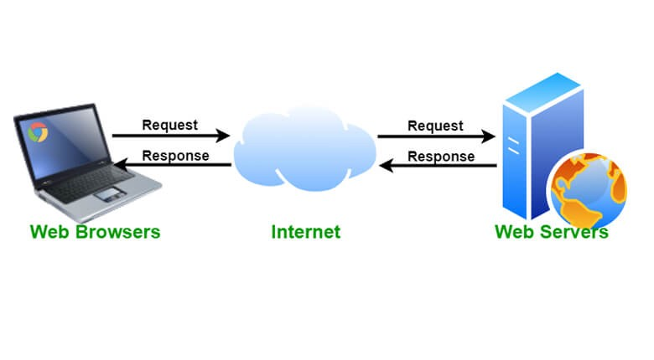
How does the web work?
The web browser connects to the web server and sends an HTTP request (via the protocol stack) for the desired web page.
Web servers and web browsers communicate via HTTP
HTTP ensures that all parts of the web page are delivered
Web browser decides how these items are displayed
The backbone of the web is the network of webservers across the world. These are really just computers that have a particular type of software running on them - software that knows how to speak the HTTP protocol and knows which information stored on the computer should be made accessible through the web.

Slide 2
What do you need to be a web developer?
While there are no formal or specific qualifications required to become a web developer, a numerate degree in a subject such as maths or science will be useful.
You should also ideally have an aptitude for - or experience of - elements such as:
User experience (UX)
User interface (UI)
Visual design
Coding languages including HTML and CSS
Frontend web programing languages and skills such as JavaScript, Ajax and web animation techniques
Backend web programing languages such as C# or Java, PHP and Ruby
Design software like Photoshop and Illustrator and Sketch
An understanding of SEO
Web servers and how they function
A career as a web developer is very specialised. While programs such as Adobe Dreamweaver and platforms such as WordPress are often perceived to take the place of core coding skills - and they do indeed allow novice users to create sites with basic knowledge - developing sites for corporate clients requires high levels of customisation which cannot be met with the use of programs such as Adobe Dreamweaver, as web developers are required to code in the raw language of the web.

Slide 3
What is the role of a web developer
The role is responsible for designing, coding and modifying websites, from layout to function and according to a client’s specifications. Strive to create visually appealing sites that feature user-friendly design and clear navigation.

Slide 4
Web Developer Job Duties:
Regular exposure to business stakeholders and executive management, as well as the authority and scope to apply your expertise to many interesting technical problems.
Candidate must have a strong understanding of UI, cross-browser compatibility, general web functions and standards.
The position requires constant communication with colleagues.
Experience in planning and delivering software platforms used across multiple products and organizational units.
Deep expertise and hands on experience with Web Applications and programming languages such as HTML, CSS, JavaScript, JQuery and API’s.
Deep functional knowledge or hands on design experience with Web Services (REST, SOAP, etc ..) is needed to be successful in this position.
Strong grasp of security principles and how they apply to E-Commerce applications

Slide 5
Web Developer Skills and Qualifications:
JavaScript, JQuery, HTML, HTML5, CSS, CSS3, Web Programming Skills, E-Commerce, Teamwork, Verbal Communication, cross-browser compatibility, Web User Interface Design (UI), Security Principles, Object-Oriented Design, Web Services (REST/SOAP), Multimedia Content Development, API’s

